Slide 1
Salary and Compensation Analysis Through Excel Data Modeling
STUDENT NAME : Parameswari.G
REGISTER NO : 122204544/46B6D87C3A9BF62952146169E1
DEPARTMENT : B.com (cs)corporate secretaryship
COLLEGE : Kanchi Sri Magalakshmi arts and science for women college

Slide 2


PROJECT TITLE
Salary and Compensation Analysis Through Excel Data Modeling

Slide 3
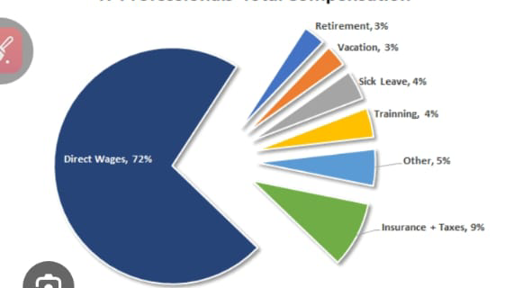


AGENDA
Design Your Sales Compensation Plan
Modeling Prevents Misalignment
How to Model Incentive Compensation Plan Outcomes in Excel
Model outputs
Refine and calibrate
Monitor continuously
Results
Conclusion
3/21/2024 Annual Review

Slide 4


DESIGN YOUR SALES COMPENSATION PLAN
Before we dive into the mechanics, you should have completed the incentive plan design phase, including:Setting metrics that are strategically aligned with the business objectives/priorities and market best practicesDeciding on the overall incentive plan structure (e.g., target pay, performance measures, weights, measurement, period, frequency, etc.)

Slide 5


Modeling Prevents Misalignment
.
Modeling Prevents Misalign mentOnce you have determined all those elements, you are ready to cost model the incentive plan and assess the impact this plan will have on individuals' pay, the cost to the company, and whether it will motivate the right behaviors .Invest the time in modeling as many scenarios as possible; Incorrectly modeling a plan or skipping this step in the design process can result in profound cost implications for the company and misaligned goals that can impact results and demotivate your sales team.

Slide 6


HOW TO MODEL INCENTIVE COMPENSATION PLAN OUTCOMES IN EXCEL
Step 1: Data collection First, we must collect all of the data that is relevant and informative to our model.
Employee Details
Compensation Data
Performance Data

Slide 7


Step 2: Define your model inputs Create a section in your workbook for all the plan inputs you want to model. These inputs will be used to calculate the pay under the new plan and will be calibrated, adjusted, and refined to get the desired outcome.
Example
Target Pay Mix (used if % split of base salary/target incentive is being modeled) - e.g., 70% base salary / 30% target incentive/variable compensation.

Slide 8
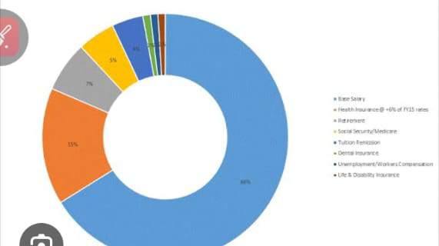
Step 3: Model calculations Once you have all the necessary data and plan inputs set up, you are ready to model the plan and calculate
the new payouts for each individual using historical
performance as a proxy for future sales performance..

Slide 9


MODEL OUTPUTS
Create different outputs to aggregate and summarize new incentive plan results. That will help ensure the plan is structured correctly to align with overall outcomes. Review by role, individual (most significant increases and decreases in pay), and team or region, if appropriate.
The goals of this phase are:
Ensure average and top performers can adjust their performance to succeed under the new comp plan design .
Ensure who receives the earnings makes sense, given historical performance levels and your priorities around activities and behavior.
3/21/2024 Annual Review
9

Slide 10

REFINE AND CALIBRATE
Refine and calibrate This is where the "art" of sales compensation comes into play, where you adjust the plan inputs to determine how much they shift the outputs. At this stage, all the work setting up the model to feed as many dynamic inputs as possible pays off. Adjusting the rate or the payout curve automatically results in the updated pay and updated outputs to review, so you can quickly see if your adjustments have the desired effect on outcomes.
10

Slide 11

MONITOR CONTINUOUSLY
Monitor continuously This is where the modeling stops for many organizations, but they are missing a huge opportunity by doing so. We recommend our clients approach their comp plan modeling as an ongoing exercise, which turns the hypothetical model into a real-time measure of realized performance.
As data is produced throughout the year, update the inputs section of your model to see how actual performance is tracking against your modeled outcomes, adjusting the calculations to iron out any discrepancies you find. That will allow you to forecast end-of-year results with greater accuracy and make your model more reliable in the future.
11

Slide 12

RESULTS
12

Slide 13


CONCLUSION
The "Salary and Compensation Analysis Through Excel Data Modeling" project provides a robust and user-friendly solution for evaluating and managing employee performance. By leveraging Excel's powerful tools—such as filtering, pivot tables, charts, and conditional formatting—the project transforms raw performance data into actionable insights. The resulting interactive dashboards and customizable reports empower managers to make data-driven decisions, optimize workforce productivity, and foster continuous improvement across the organization. This solution not only streamlines performance management but also offers a cost-effective, scalable approach to enhancing overall organizational efficiency.

